Slide 1

KEFRI 2ND MONTHLY SCIENTIFIC COLLOQIUM ON SHARING SCIENCE FOR FORESTRY SECTOR DEVELOPMENT AND VISIBILITY
THE ROLE OF FORESTRY RESEARCH IN TRADE AND SOCIOECONOMIC DEVELOPMENT IN KENYA TO THE 21ST CENTURY
5TH MAY 2022-KEFRI AUDITORIUM
“The forestry sectors requires value driven researchers with vision dream that transcends generations to transform lives of our people into prosperous country ’’
Dr. Joshua K. Cheboiwo (PhD), Senior Principal Research Scientist, Director KEFRI

Slide 2
FAO FOREST CONFERENCE 1950: PRINCIPLES OF FORESTY
FAO Forest Conference on Principles of Forest Policy 1952
Forests are important resource for economic, social, and physical balance of the world.
Forests conservation and utilization as renewable source of products indispensable man.
Forests when sustainable used by resource endowed states will provide supplies for less endowed states
Forest industries and market value chain creates employment hence an important element of social stability and progress of the world.
Trade in forest products generates surplus foreign exchange and wealth creation

Slide 3
NATIONAL FOREST POLICY 2016: FOREST PRODUCTS AND INDUSTRIES
National Forest Policy 2016: Forest products and Industries.
Sustainable supply of wood for subsistence and industrial needs from all forests
Investment in wood industry to for processing and value-addition.
Promote investments for large scale and SMEs for diverse forest based industries and enterprises.
Support efficient production and marketing of forest products for the local and export markets.
Establish a chain-of-custody and certification for national and international trade in wood and wood products

Slide 4
OVERVIEW OF FORESTRY SECTOR IN KENYA
Forestry sector contributes 3.6% to the GDP estimated annual turnover US$ 785,440,000 (KES 78.5 billion)
The land categories community, public, private and farms.
Several goods and services various economic sectors
Players are farmers, companies, social investors, public agencies
Utilization include saw millers, wood preservers, food processors, biomass energy sectors, pulp and paper, reconstituted woods
Gatsby Africa projects that by 2020 supply deficit of 10.3 million m³.
Additional potential for 200,000 Ha US$50 million (KES 5 billion), 11,000 skilled jobs and turnover US$261 million (KES 26.1B per year
Private sector brings in the desired land, financial capital and operational efficiency
Driver good policies, laws, technical support and good prices

Slide 5
TabFle 2: Forest agnd tree cover (ha) trends
Forest type | 1990 | 2000 | 2005 | 2010
Indigenous closed forests | 1,240,000 | 1,190,000 | 1,165,000 | 1,140,000
Indigenous mangroves | 80,000 | 80,000 | 80,000 | 80,000
Open woodlands | 2,150,000 | 2,100,000 | 2,075,000 | 2,050,000
Public plantation forests | 170,000 | 134,000 | 119,000 | 107,000
Private plantations | 68,000 | 78,000 | 83,000 | 90,000
Subtotal | 3,708,000 | 3,582,000 | 2,357,000 | 3,467,000
Bushland | 24,800,000 | 24,635,000 | 24,570,000 | 24,510,000
Farms with Trees | 9,420,000 | 10,020,000 | 10,320,000 | 10,385,000
Total | 41,636,000 | 41,819,000 | 40,769,000 | 41,829,000

Slide 6
GLOBALIZATION AND TRADE: INTRA AFRICA TRADE
Globalization is largely driven by international trade
Economic blocks EAC, COMESA), SADC and (CEN-SAD)
African Free Trade Area (AfCFTA) in 2018 world's largest
intra-African exports is lowest 17% Europe (69%), Asia (59%), and North America (31%).
AfCFTA intra-African trade growth 15% or $50 billion and 25%or $70 billion by 2040
Mostly in manufactured goods accounting for 41.9% as compared to 14.8% exports in 2014.
AfCFTA promote growth of SMEs, innovation as more markets open and productivity.
Forests in Africa support local livelihoods, provision of ecosystems good and services
Huge investment in forests production, processing and trade

Slide 7
GLOBAL AND AFRICA FORESTS AND RESOURCES IN ‘‘000S HA
 | 1990 | 2000 | 2010 | 2020
World | 4,236,433 | 4,158,050 | 4,106,317 | 4,058,931
Europe-Russia | 994,319 | 1,002,268 | 1,013,982 | 1,017,461
South America | 973,666 | 922,645 | 870,154 | 844,186
North and Central America | 755,279 | 752,349 | 754,190 | 752,710
Africa | 742,801 | 710,049 | 676,015 | 636,639
Asia | 585,393 | 587,410 | 610,960 | 622,687
Oceania | 184,974 | 183,328 | 181,015 | 185,248

Slide 8
FOREST RESOURCES IN AFRICA IN 000S HECTARES

Slide 9
FOREST RESOURCES REMOVALS IN MILLION CUBIC METRES

Slide 10
RATIONAL FOR PROMOTION OF TIMBER TRADE
Africa is endowed with a large population and large diversified natural resources endowments
Promote intra country trade and investments to create employment, income generation and overall continental economic development
Kenya is key partner in AfCFTA benefit from continental efficient flow of goods and services
The intra timber trade in Africa in timber account for paltry 5% of the total trade volume traded globally.
Kenya is largest importer of timber in the Eastern Africa stands to benefit from intra Africa timber trade.
To enhance Kenya’s trading position as a hub of woodworks manufacturing for local and export markets

Slide 11
RATIONAL FOR PROMOTION OF TIMBER TRADE
Trans Africa Highways 8 Mombasa to Lagos and 4 Cairo-Gaborone and interconnections timber trade timber trade
In 2009 and 2014, Cameroon exported 3.5 million m³ of logs Asia accounted for about 89%, Europe (9%) and Africa (2%).
3.45 million m³ of sawnwood Europe (67%), Africa (7.4%),
Veneers, about 82% of the 203,799 m³ to Europe, 11% to Africa
Plywood, Europe 67.8%), Africa (29.7%), Asian 1.9%
Africa has small internal markets, dependence on imports of manufactured products, low manufacturing capacity and dominance of foreign industrial firms in logging and processing operations
Africa need to attract investment in forest operations and manufacturing
Kenya should be in the forefront in investing local and regional manufacturing operations for import to local markets and export overseas markets

Slide 12
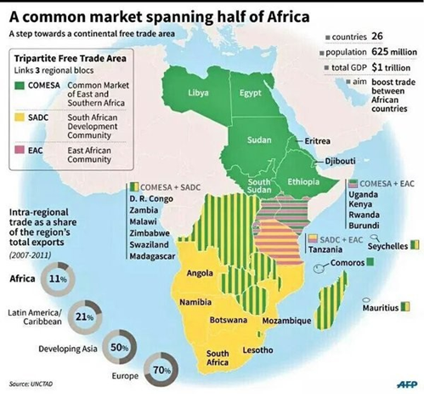

Slide 14
WOOD MANUFACTURING AND CAPACITY IN EAST AFRICA
Sawmilling dependent on public plantations.
Kenya has the highest (633) followed by Uganda (180). Tanzania hosts the largest sawmills
Sao Hill 48,000m³, Mufundi Paper Mill (MPM) 46,000MT, KVTC (45,000 m³) and TANWAT (20,000 m³).
Tanzania exported to Eastern and southern Africa
PPM) before collapse in 2009 was largest 500,000m³/yr
Sawmills of sawmills recovery rates, 26-35%.
Three Kenyan Rai Ply, Comply and Timsales, are the largest integrated saw milling, plywood, and particle boards
Diversified products foam and polythene bags for local and export markets.
The complexes expanded operations into Tanzania and Malawi.
Trade in mostly in manufactured goods hence more investment in mafacturing plants in the country

Slide 15
TRADE IN MANUFACTURED FOREST PRODUCTS
In 2015 Kenya imported manufactured forest products worth USD 241million (KES 24.1billion)
Imports sources East Africa and wider Africa, Europe
The manufactured boards, paper and paper products, furniture etc
Exported USD 40841099 (KES 4.0 billion) a deficit of KES 20 billion.
Exports cork, wood carving, paper, and wattle bark
Importing countries Sudan, DRC , Rwanda, South Africa, Uganda, Tanzania, Ethiopia, Cameroon, Zimbabwe and Western Sahara.
Others include Israel, Italy, England, Belgium, Norway and China

Slide 16
KENYA POSITION IN FOREST PRODUCT TRADE WITH TANZANIA

Slide 17
FOREST PRODUCTS IMPORTS FROM TANZANIA FOR 2010-2020

Slide 18
POLICY AND LEGAL FRAMEWORKS
FCMA 2016) recognizes treaties, conventions and international agreements relation to forests to which Kenya is a party.
CBD, EAEC, CITES, UN, AU, ITTO.
CITEs: Restricts trade in sandalwood, Prunus and Dalbergia products
FCMA, 216 outlines Chain if Custody procedures in import and export
The FCMA 2016: Provisions for certification CoC for production and trade
Ministerial Declaration on Africa Forest Law Enforcement and Governance (AFLEG) ‐ Yaoundé, Cameroon, 2003;
EAC) Treaty (1999) and EAC Protocol on Environment and Natural Resource Management:Article 11 on Management of Forests and Trees.
The EAC Trade protocol include various wood products for trade
KFS, KEPHIS, KRA have some roles in export and imports of forest products
African Free Trade Area 2021

Slide 19
CRITICAL ROLE OF RESEARCH ON FOREST SECTOR DEVELOPMENT
Enhanced Primary Production and Productivity
Efficiency in Secondary Processing
Diversified forest products in the forest sector
Investments in the woodworks sector: Furniture and joinery.
Facilitate product development and manufacturing hubs
Explore emerging opportunities-Reconstituted and Engineered woods, NTFPs
Research on forestry products markets and Trade

Slide 20
ROLE OF RESEARCH IN TRANSBOUNDARY TREE PRODUCT TRADE
Segregation of records of forestry products into species, quantities and values
Assessment of the capacity of relevant agencies on forest products imports and exports at the all border points.
Generate valuable information regarding origin and volumes of timber coming into the country and going out of the country
Trends to control and eliminate illegal logging and trade
Timber tracking systems for verification of the legality of timber across borders
Regional instrument to promote legal logging and trade in forest products
Central depository of data and information on forest products trade
Evaluate the forestry products trade governance systems and impacts on sustainable forestry resources.

Slide 21
EVOLUTION OF RESEARCH ON TRADE IN FOREST PRODUCTS
Since 1999 KEFRI undertakes research on forest products markets in Kenya and East Africa.
KEFRI the leading agency in the regions on forest product market research and trade.
KEFRI undertaken consultancies for FAO, IUCN, EAC, AWS, LVBC,
KEFRI has widely published results and created awareness on forest products trade
KEFRI Research Future Direction
Data and information on regional and International trade flows
Focused attention on key segments with greater potential investment and growth –SMEs, Furniture, handicrafts, reconstituted wood etc
Performance of key facilitation instruments mostly policies and laws
Development of policy statements and information on trade to influence decisions at various levels
Holding of local and international commercial Conferences and trade fairs

Slide 22
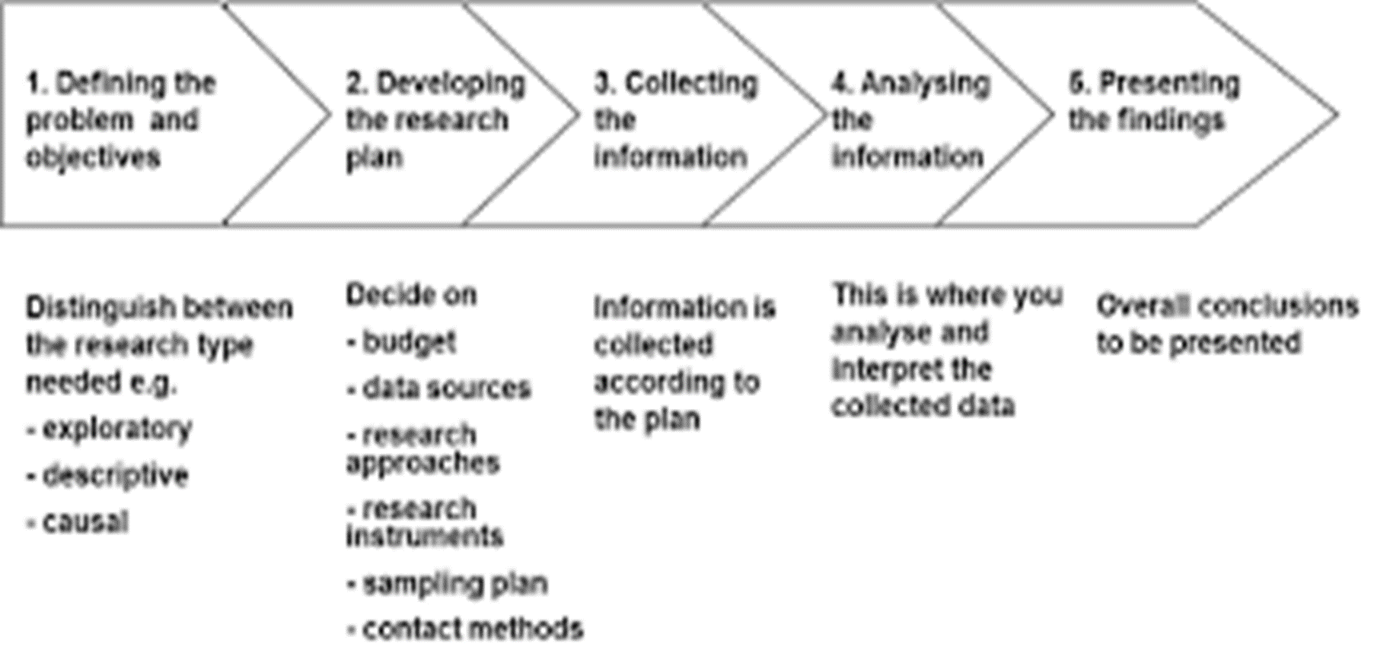
PLANNING AND IMPLEMENTATION OF MARKET RESEARCH

Slide 23
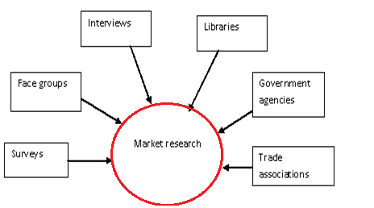
MARKET RESEARCH SURVEY DATA SOURCES

Slide 24
KEY METHODS ON ECONOMICS AND MARKETS RESEARCH
Forest Economics and Market Research Tools
Research is guided by convention research tools and international standards
Land use and Investment Decision Tools
Cost benefit Analysis-NPV, Annual Equivalent, (AE), internal rate of returtn to investment capital (IRR), and cost benefit ration (CBR)
Policy: Analysis of Policy and Policy analysis: Criteria and Indicators
Market Research Analysis Tools
To evaluate market performance several tools are available that include the following:
Von Thunen zoning
Gross Marketing Margin (GMM)
Operational technical efficiency
Market integration
Market-cointegration
Market efficiency
Market correlations

Slide 25
OPPORTUNITIES ON TRADE IN FOREST PRODUCTS
Africa has vast forestry resources but production, processing and intra Africa trade is relatively low
Need for policy and legal frameworks to facilitate investment in industries and infrastructure to enhance transboundary trade.
Kenya have sufficient trade infrastructure in place for forest products trade that emerged during the two logging bans 2002-2012 and 2018-2021
Good trade link to Tanzania and DRC among others ECA countries
Fairly policy and legal frameworks for transboundary timber trade with nascent wider regional integration initiatives
Huge market for forest products currently served by global and regional imports Viable for investment in production and manufacturing mostly timber, plywood, furniture and paper products
Emerging private and social syndicate investors in smallholder tree growing as part in green investment strategies likely to bring more roundwood into the market

Slide 26
RECOMMENDATIONS
Enhanced sustainable management of natural and plantation forests in Kenya and Central Africa countries for sustainable supply of roundwood.
Support to growth of efficient SMEs and large industrial manufacturing plants with for diverse wood sector enterprises.
Development of regional, continental and global certification and chain of custody infrastructure to link the country to its target products sources and markets
Kenya should position itself as woodwork hub from local and imported timber for local and export markets
Focus on standardized designs for mass production for uniformity and scale cost cutting production
Training of local manpower on latest skills in forest production, manufacturing and marketing
Enhanced access to high quality and competitively priced raw materials from local and regional sources for the countrys woodworks manufacturing hub
Forestry sector should be marketed as an investment destination for greater socioeconomic development, employment and forex earner through exports.

Slide 27
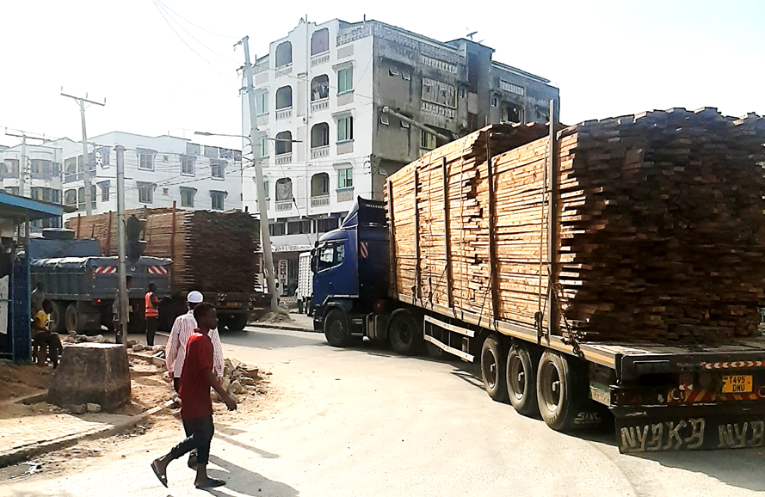
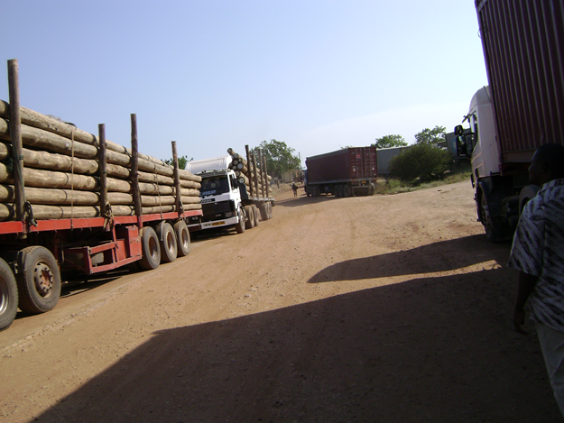
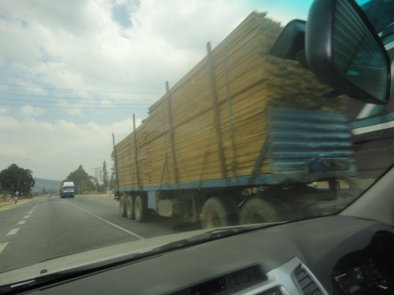
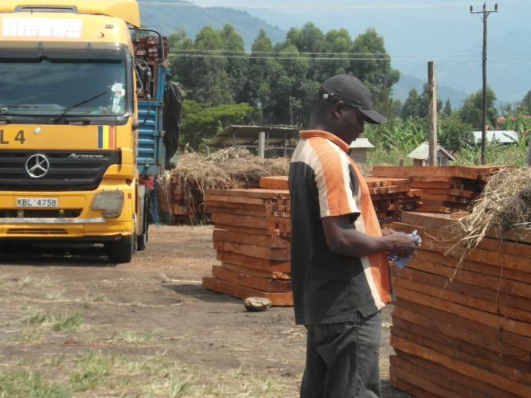

Slide 28
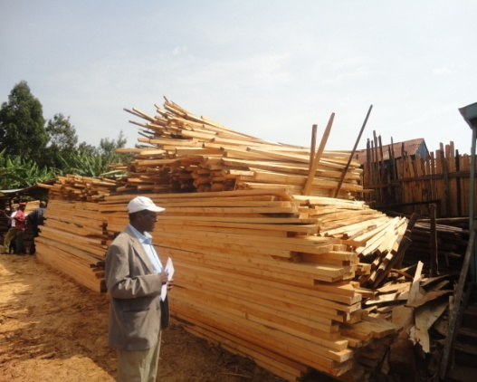
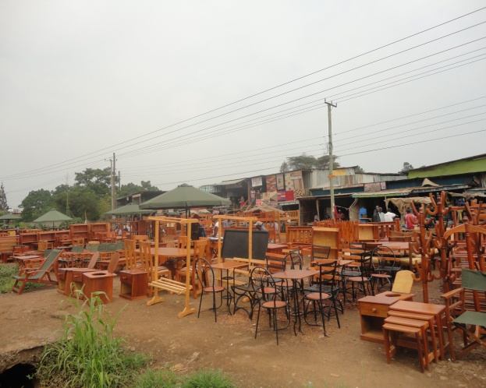
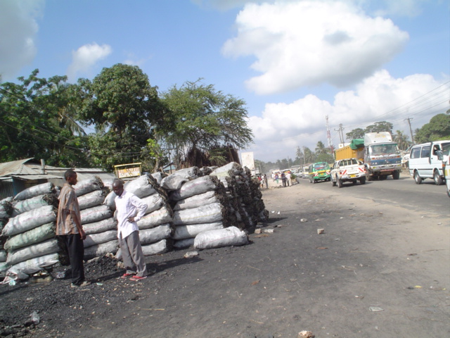
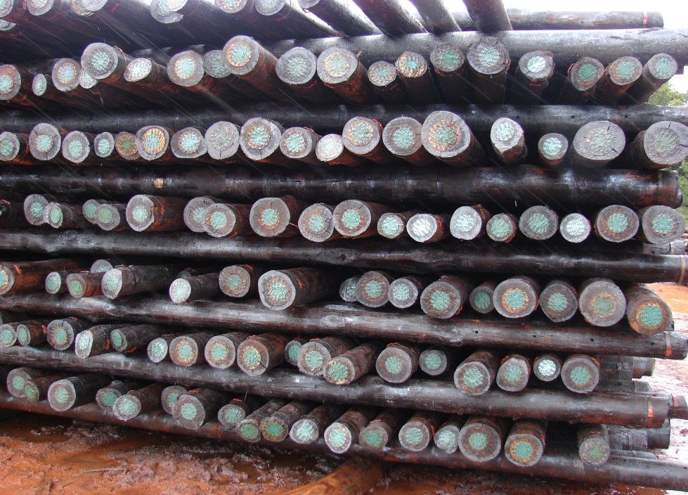

Slide 29

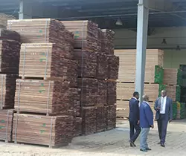
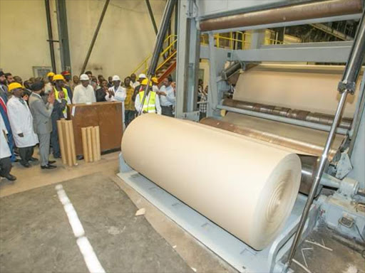

https://www.google.com/url?sa=i&url=https%3A%2F%2Fwww.itto.int%2Feconomic_market%2Ftimber_trade%2F&psig=AOvVaw3kYaJvCwduzRKIj8FawLY1&ust=1651738583984000&source=images&cd=vfe&ved=0CAkQjRxqFwoTCNj7y-6zxfcCFQAAAAAdAAAAABAh

Slide 30
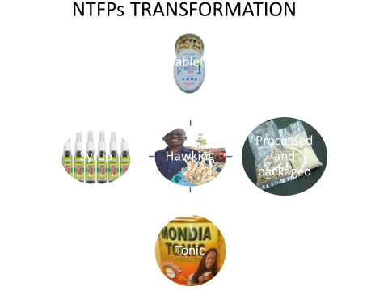
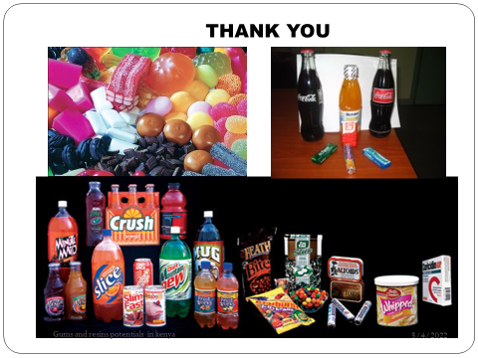

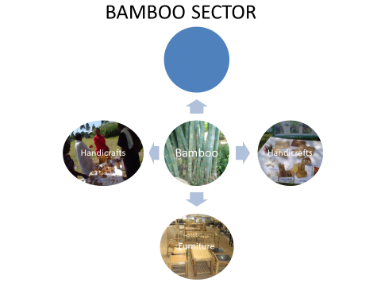
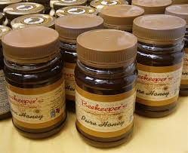

https://www.google.com/url?sa=i&url=https%3A%2F%2Fwww.itto.int%2Feconomic_market%2Ftimber_trade%2F&psig=AOvVaw3kYaJvCwduzRKIj8FawLY1&ust=

Slide 31
NTFPs TRANSFORMATION
Hawking
Tablets
Processed and packaged
Tonic
Syrup

Slide 32


