Slide 1
Visibility and Impact for 21st Century Scientist
Dr. Sammy Letema
Chairman, KEFRI Board
April 4th 2022

Slide 2
Rudimentary Category of Science
Science of doing
    Routine data collection
Science of thinking
    Address a problem
    Analytical
Science of deep thinking
    Creativity
    Patent
    Innovation

Slide 3
Scientists Pathway
Research
Writing
Analysis
Research
Proposal
Analytic
Skills
Administration
Leadership
Concepts
Principles
Mentorship
Mentorship
Learning
Basic & BSc/BA
Masters
PhD
Capacity Building
Reports
Publication
Presentation
Publications
Productivity
Awards
Science leaders
Grants
Innovations

Slide 4
KEFRI Publication Visibility 2019/2022
Category of Scientists | No. Staff | Publications in Scopus
 |  | 0 (%) | 1-3(%) | 4-9(%) | <10(%)
All 2019 | 98 | 58 (59) | 30 (31) | 5 (7) | 3 (3)
All 2022 | 118 | 72 (61) | 32 (27) | 12 (10) | 2 (2)
 |  | Publications in Google Scholar
 |  | 0 | 1-10 | 11-30 | >30
All 2019
All 2022 | 118 | 46 (39) | 26 (22) | 27 (23) | 19 (16)
60% in 2019 of KEFRI Scientists are not engaged in science! 10% in 2019 of KEFRI Scientists are Productive
61% in 2022 published >1 paper indexed by google scholar 36% in 2022 of KEFRI Scientists are visible (h-index>3 Scholar)

Slide 5
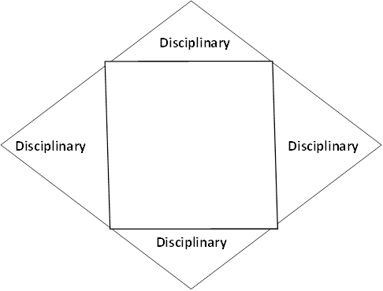
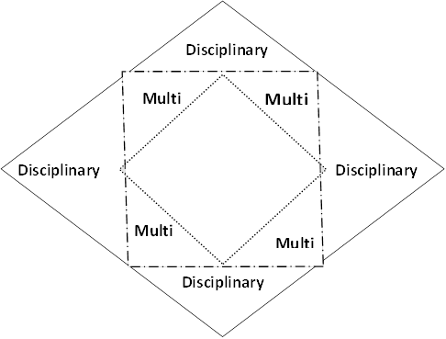
Re-orienting Research for Impact
Transform
Discipline to novel
KEFRI Scientists fight each other!
Novel
Transform
Self to collaboration
High visibility/impact at multi & novel research
Require collaborations!

Slide 6
Research, Visibility & Impact
KEFRI research Program
Centre
Region
Independent
High Visibility/Impact
High impact publications
Patent/ innovations
Technical/Science reviews
>10/i10 h-index
Commercialization of research outputs
Policy & public realm
Collaborations
Research Accounting
Webometrics
Research grants
Science based productivity measure
Motivation
Low Visibility/Impact
Technical notes
Policy briefs
Guidelines/orders
Protocol/standard
Conference/Chapter
Publications in predator/non-indexed journals

Slide 7
Research Development = Impact
Scientist maxim is no longer publish or perish
Research is much more than peer review papers & high impact
Research is both pursuit of new knowledge for its own sake and to solve societal problems
Solving problem = impact
New visibility
Social media
Newspaper spaces
Radio/TV commentaries
New Visibility Requires
Retraining
Retooling
Appropriate communication

